Slide 1

ALL ABOUT LOGO DESIGNS
PRESENTED BY AKSHAT NEGI

Slide 2
A TIMELINE TO SHOWCASE PRESENTATION
GOOGLE
INSTAGRAM
RAZER
FENDER
1
2
3
4
5
DEAN
Mercury is quite a small planet
Neptune is very far from the Sun
Mars is full of iron oxide dust
Jupiter is an enormous planet
Jupiter is an enormous planet

Slide 3

GOOGLE
The Google logo is characterized by its colorful and playful design. It consists of the company name "Google" spelled out in a sans-serif font with four different colors: blue, red, yellow, and green.
Each letter is a different color, and the arrangement of colors creates a vibrant and dynamic appearance. The logo is known for its simplicity and reflects Google's innovative and diverse approach as a technology company.

Slide 4

INSTAGRAM
Pink represents creativity and innovation
Purple symbolize luxury and uniqueness
Orange associates with energy and enthusiasm.
The Instagram logo consists of a stylized camera icon with a gradient of various colors, predominantly pink, purple, and orange. The iconic camera icon symbolizes the platform's focus on visual content, particularly photos and videos. The gradient colors add a playful and vibrant touch, reflecting the diverse and creative nature of the content shared on the platform.Colors:
Collectively, these colors convey a sense of creativity, diversity, and dynamic content-sharing on the platform.

Slide 5
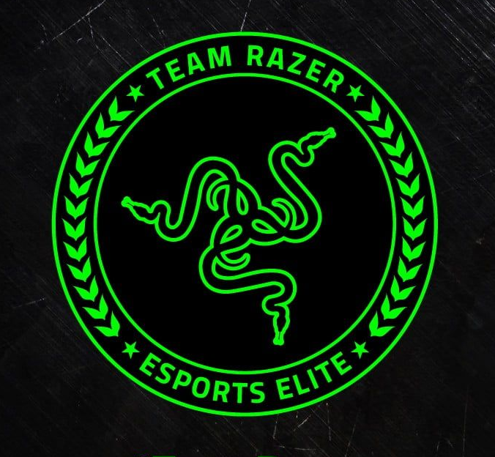
RAZER
Green color has become iconic for the brand, symbolizing energy, innovation, and the dynamic world of gaming. The sleek black background further enhances the visibility and impact of the Razer Green color in the logo.
The triple-headed snake emblem known as the "Triple-Headed Snake" or "Tri-Snake." The snake is enclosed in a diamond-shaped icon, and the overall design conveys a sleek and modern aesthetic. The green color is often associated with Razer and is known for its vibrant and eye-catching appearance.

Slide 6

FENDER
Black color for the font contributes to a classic and timeless aesthetic, aligning with Fender's reputation for producing iconic and enduring musical instruments. The simplicity of black adds a touch of sophistication to the logo, emphasizing the brand's longstanding presence in the music industry.
The Fender logo features a distinctive design with the brand name "Fender" written in a bold, uppercase, black font. The letters are slightly elongated, and the whole logo has a sleek and timeless appearance. It often appears against a white or contrasting background.

Slide 7

DEAN
"Dean" in a bold and stylized font with an elegant and distinctive winged design that extends from the letters. The wings, adds a sense of dynamism and associations with freedom or creativity.
The choice of font and the incorporation of wings may vary across different iterations of the logo, but collectively, they contribute to an image of individuality and style, aligning with Dean's reputation in the music industry particularly in the realm of guitars and musical instruments.

Slide 8
THANKS!
Akshat Negi
B.Tech CS (CSF)
SAP ID- 500106533

